Slide 1
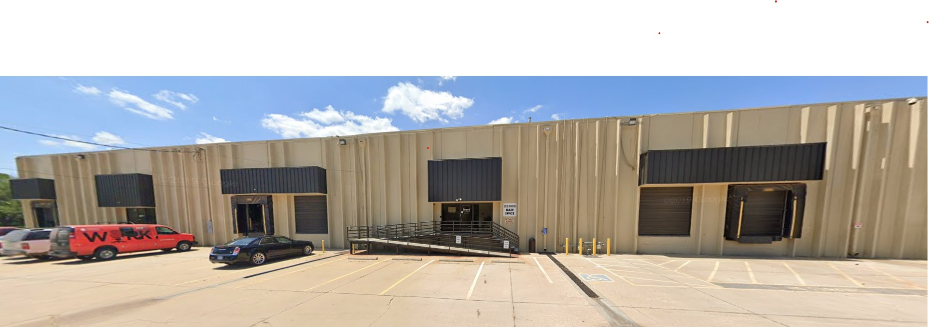
FOR LEASE
816 E. Funston Street, Suite 3 | Wichita, KS 67211
Warehouse or Distribution Facility
CHRISTIAN M. MADSEN
Phone: 316-293-3734
cmadsen@wamllc.com
AVAILABLE SPACE February 1, 2024 20,000 square feet TOTAL BUILDING SIZE 60,000 square feet LOT SIZE 90,000 square feet ZONING Limited Industrial PARKING 56 spaces in east lot across alley with 24 spaces inside a fenced lot 10 spaces in front of the offices CEILING HEIGHT Approximately 20’ clear LIGHTING T8 lighting in offices, T8 lighting in warehouse, and LED lighting around the exterior of the building. . | LOCATION Southwest of the intersection of Harry Street and Washington Avenue LEASE RATE $6,600 per month plus $1,356 estimated monthly taxes and insurance ROOF TYPE Modified bitumen HEATING & AIR CONDITIONING Warehouse – Fully heated Office – Split unit heat & AC FLOORS 6-inch reinforced concrete in warehouse. DOCK DOORS (3) - 9’x10’ dock doors with edge style levelers EXTERIOR DETAILS Prestressed concrete panels for both the walls and the roof deck

Slide 2
FOR LEASE
816 E. Funston Street, Suite 3 | Wichita, KS 67211
Warehouse or Distribution Facility

Slide 3
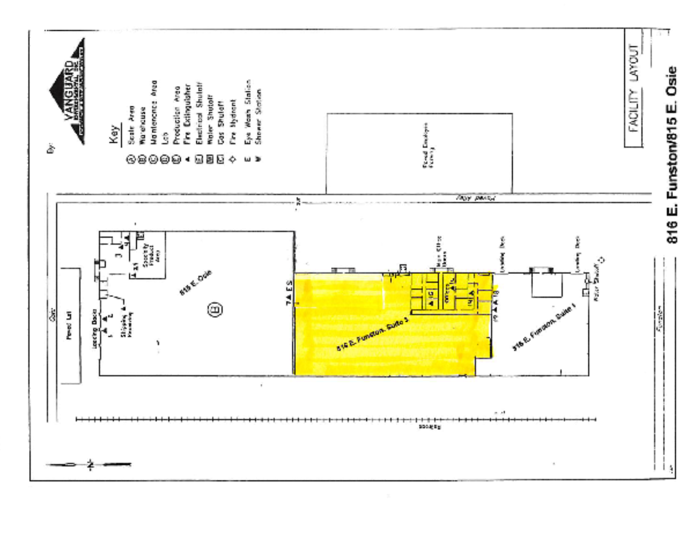
FOR LEASE
816 E. Funston Street, Suite 3 | Wichita, KS 67211
Warehouse or Distribution Facility
FLOOR PLAN

Slide 4
FOR LEASE
816 E. Funston Street, Suite 3 | Wichita, KS 67211
Warehouse or Distribution Facility
AERIAL VIEW

